Slide 1

Umibato: estimation of time-varying microbial interaction using continuous-time regression hidden Markov model
ISMB/ECCB2021
Proceedings Track Presentations
◯Shion Hosoda^{1,2*}, Tsukasa Fukunaga^{3,1}, Michiaki Hamada^{1,2*}
1. Waseda University, 2. AIST/CBBD-OIL, 3. The University of Tokyo
*To whom correspondence should be addressed.
Notes:
Hello everyone, my name is Shion Hosoda. I'm a graduate student from Waseda University in Japan.
It's a great pleasure to be given this opportunity to present today. I would like to talk about time-varying microbial interactions.

Slide 2
Abstract
Microbial interaction estimation is an important research topic.
Conventional methods for estimating microbial interactions cannot be used to estimate time-varying microbial interactions.
We developed unsupervised learning based microbial interaction inference method using Bayesian estimation (Umibato), a method for estimating time-varying microbial interactions.

Slide 3
Outline
Background
Methods
Results
Conclusion

Slide 4
Background

Slide 5
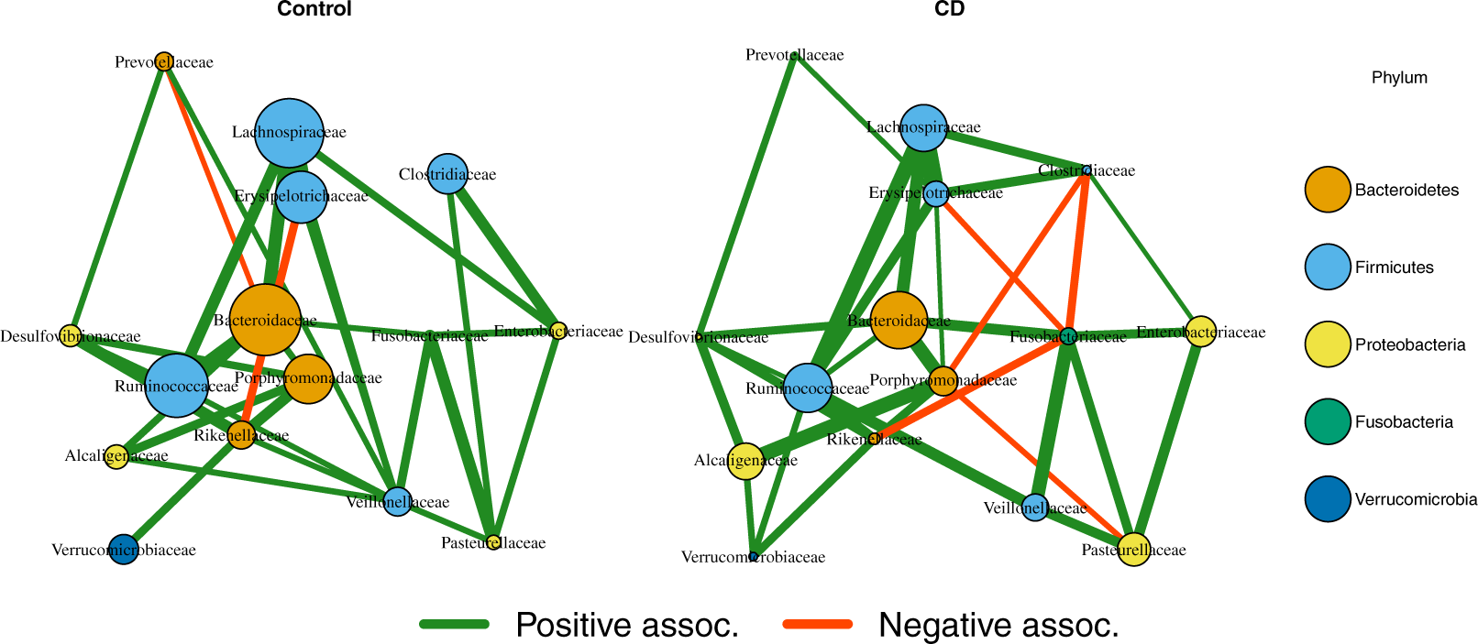
What’s microbial interaction estimation?
Microbial interactions play an important role.
For example, microbial interactions in the human gut microbiome differ between cases and controls (McGregor et al., 2020).
How to estimate microbial interactions from microbial abundances:
Correlation-based methods
Generalized Lotka-Volterra equation (gLVE)-based methods
https://academic.oup.com/bioinformatics/article/36/6/1840/5614428
Notes:
For example, this figure shows estimated microbial interaction networks in the human gut microbiome.
The left one is of controls and the right one is of cases.
We can see that they have several different edges in cases and controls.

Slide 6
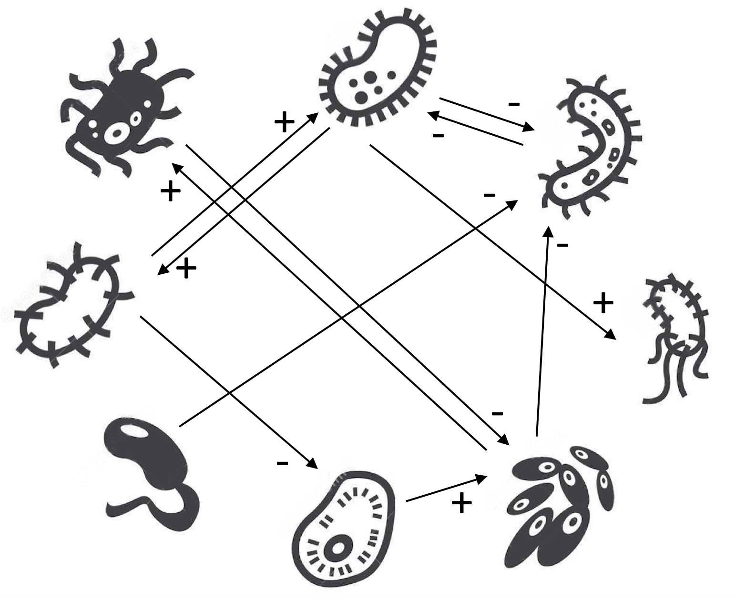
gLVE-based method enables estimating directed microbial interaction networks.
The directed microbial interaction networks show the relationship between microbes.
Competition
Symbiosis
Parasitism
http://homepages.ulb.ac.be/~dgonze/LEUVEN2017/practicals.html
Notes:
The gLVE-based method enables estimating directed microbial interaction networks.
This figure shows a directed microbial interaction network. We can see some relationships between microbes.
Symbiosis is a relationship in which microbes contribute to each other's increase.
Competition is a relationship in which microbes contribute to each other's decrease.
Parasitism is a relationship between A and B where A contributes to B's increase and B contributes to A's decrease.
These relationships are useful for revealing microbiota and the gLVE-based method have been widely used.
I'll explain the details of this method later.

Slide 7
Conventional gLVE-based methods cannot estimate time-varying microbial interactions.
gLVE assumes constant microbial interactions throughout all timepoints.
Microbe
Microbial
interaction
network
time
Same microbial interaction network at all times
Notes:
However, conventional glve-based methods cannot estimate time-varying microbial interactions.
This illustration shows estimation of conventional glve-based methods.
In this illustration, the axis indicates time, and each square indicates estimated microbial interaction network at each timepoint. Each circle in the square indicates microbe.
Like this illustration, glve assumes constant microbial interactions throughout all timepoints.

Slide 8
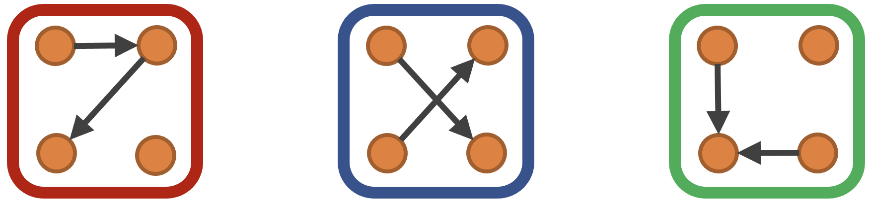
Aim of this study is to estimate time-varying microbial interactions.
Depending on the conditions of the environment, microbial interactions can change.
e.g., microbial interactions have been reported to differ in environments that contain different nutrients (Embree et al., 2015).
The inability to estimate time-varying microbial interactions is a critical limitation.
Condition1
Condition2
Condition3
Notes:
Depending on the conditions of the enviroment, microbial interactions can change.
For example, it is reported that microbial interactions differ in environments that contain different nutrients.
Therefore, the inability to estimate time-varying microbial interactions is a critical limitation.
The aim of this study is to estimate time-varying microbial interactions.

Slide 9
Methods

Slide 10
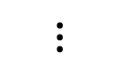
Schematic illustration of Umibato
Quantitative Microbiota
Profiles (QMPs)
Timepoint
information
2. Interaction estimation
1. Growth rate estimation
time
$$⋮$$
Log quantitative
abundance
Continuous-time regression hidden Markov model
(CTRHMM)
time
Gaussian process regression (GPR)
Notes:
In Umibato algorithm, we use QMPs and timepoint information, which indicates when each profile was obtained.
Umibato has two steps.
The first step is the growth rate estimation using gaussian process regression GPR.
We estimate gradients of logarithmic quantitative abundances.
The second step is the interaction estimation using continuous-time regression hidden Markov model CTRHMM, which is proposed in this study.
Here, we can estimate time-varying microbial interactions.
We will describe the details of Umibato in this section.

Slide 11
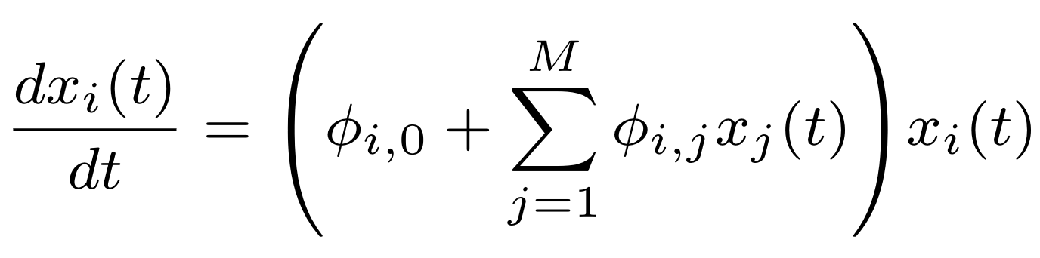
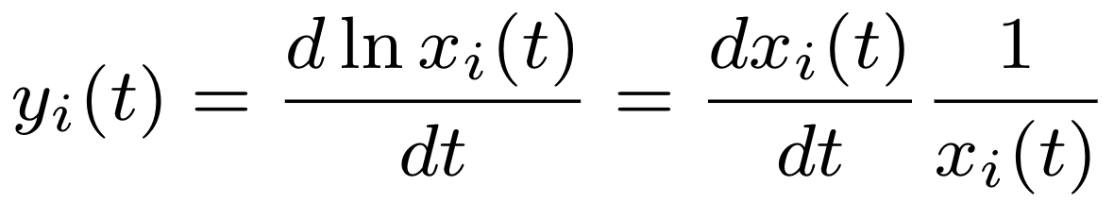
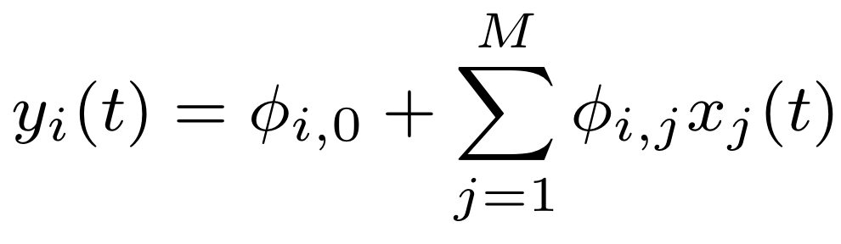

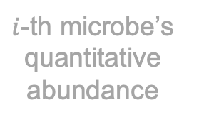
What’s gLVE-based method?
Interaction parameter
gLVE is the following equation:
It can be rewritten as follows:
Typically, $y_{i}(t)$ is estimated by interpolation methods (Gaussian process and spline), and $φ_{i,∙}$ are estimated by linear regression.
$i$-th microbe’s quantitative abundance
Growth rate
Notes:
What's the gLVE-based method?
The gLVE is this equation.
Here, x i t is the i-th microbe's quantitative abundance
phi i j is an interaction parameter from the j-th microbe to the i-th microbe.
This equation represents that the time derivative of x i t is affected by other microbes' abundances.
It can be rewritten as follows.
Here, we used the definition of growth rate y i t.
y i t equals to time derivative of x i t divided by x i t
where x and y are given.
We will replace phi with phi t, which are depending on time t.

Slide 12
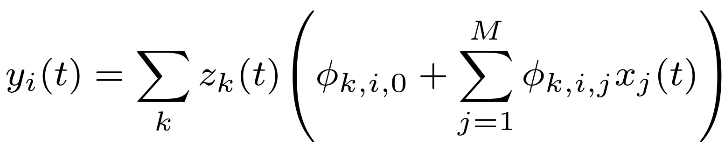
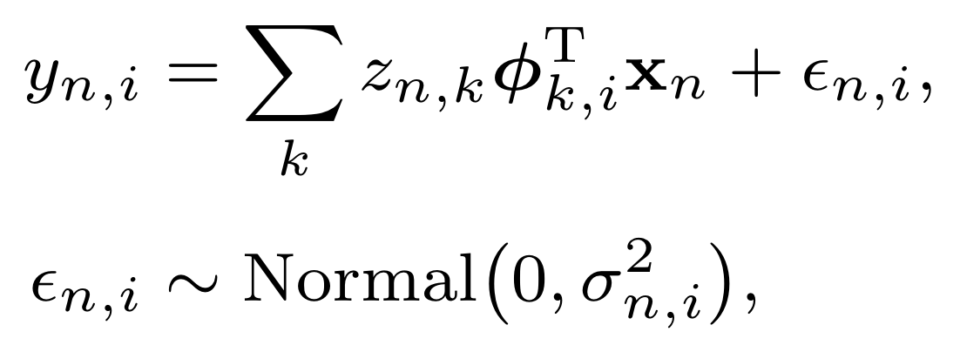
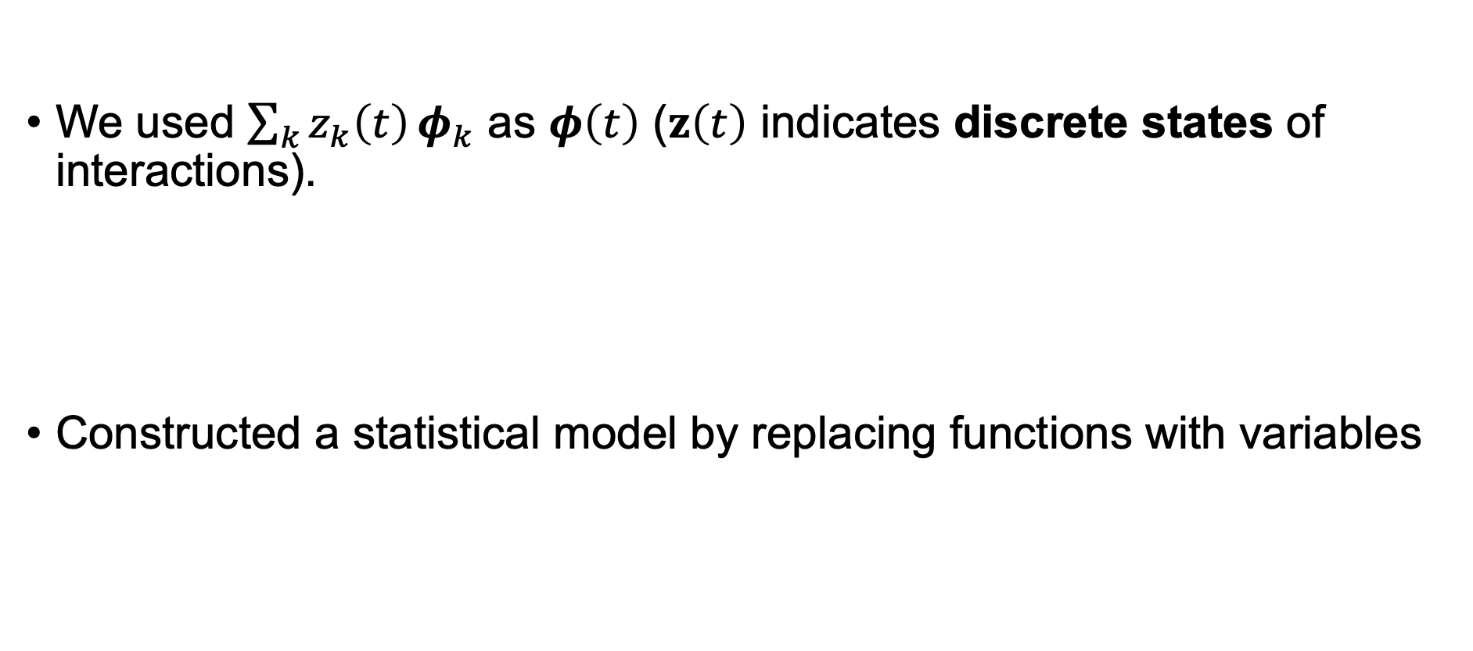
We have introduced time-varying parameters into gLVE.
We used $\sum_{k}{z_{k}\left(t\right)}φ_{k}$ as $φ\left(t\right)$ ($z\left(t\right)$ indicates discrete states of interactions).
Constructed a statistical model by replacing functions with variables
Vector inner product form including bias term
Notes:
We used a summation of z k t phi k as phi t. here, z t indicates discrete states of interactions.
Then, we obtained this formula.
To construct a statistical model, we replaced functions of time t with variables.
Then, we obtained this model.
Here, we used vector inner product form including bias term.
and epsilon is an error term.
In this model, the state determines which interaction parameters to use.
We have introduced time-varying parameters into gLVE.

Slide 13
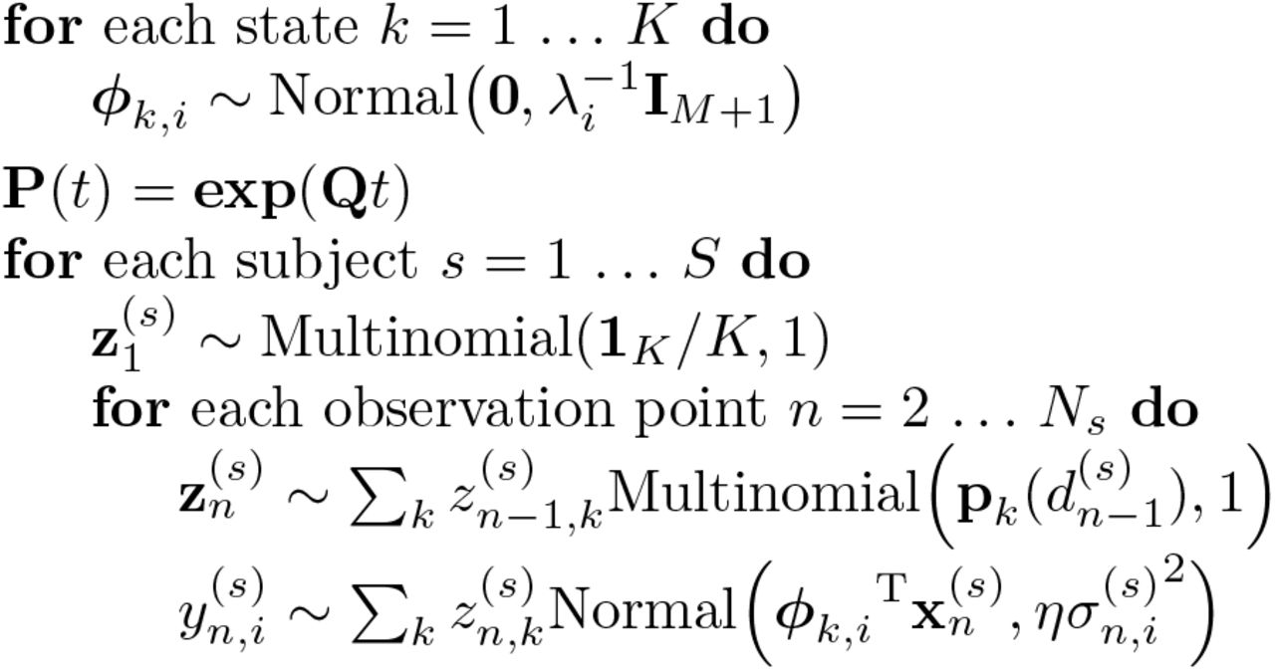
Continuous-time regression hidden Markov model (CTRHMM)
Based on the statistical model, we proposed a Bayesian model whose generative process is the following:
Continuous-time Markov chain
Generalized Lotka-Volterra equation
Notes:
Based on the statistical model, we proposed a Bayesian model whose generative process is like this.
These are the prior distributions of interaction parameters.
P(t) is a transition probability matrix depending time t, and it's computed from matrix exponentials of a product of a transition rate matrix Q and time t.
interaction states z are generated from continuous-time Markov chain, and growth rates y are generated from normal distributions based on the gLVE.
This is the CTRHMM. The parameters of CTRHMM can be estimated with a variational inference.

Slide 14
Results

Slide 15
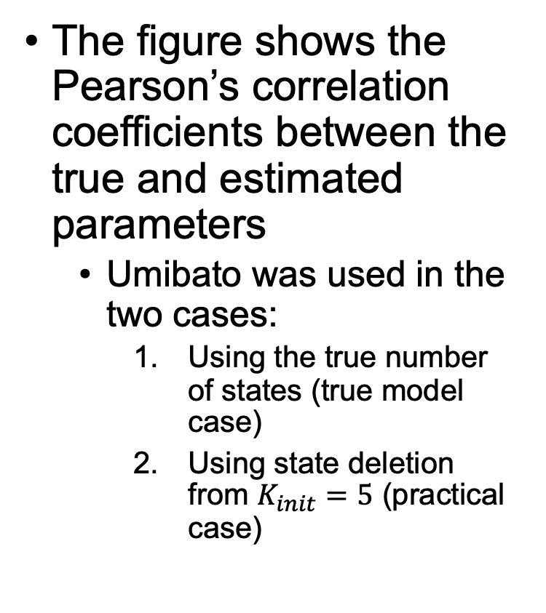
Synthetic dataset experiments showed higher performance of Umibato.
The figure shows the Pearson’s correlation coefficients between the true and estimated parameters
Umibato was used in the two cases:
Using the true number of states (true model case)
Using state deletion from $K_{init}=5$ (practical case)
Notes:
We conducted synthetic dataset experiments.
Umibato was used in the two cases.
The first case is the true model case. In this case, we used the true number of states.
The second case is the practical case. In this case, we used a state deletion. To explain it briefly, it's the method to determine the number of states during the estimation.
This figure shows the mean of the Pearson's correlation coefficients between the true and estimated parameters. The x-axis indicates a synthetic dataset. The y-axis indicates the mean of the Pearson’s correlation coefficients of gLVE parameters of all observation points for the datasets.
The six bars indicate Umibato in the true model case, Umibato in the practical case, and four conventional methods in order from left to right.
Higher bars mean higher performances.
In Dataset1, which is generated from conventional glve, Umibato and the conventional methods have similar performances.
On the other hand, in Dataset2 and 3, which consider multi-state, Umibato outperformed the conventional methods.

Slide 16
Used dataset on real data experiment
We used a mouse gut microbiota dataset (Bucci et al., 2016).
16S amplicon dataset using strain-specific qPCR primers
https://genomebiology.biomedcentral.com/articles/10.1186/s13059-016-0980-6
Notes:
A simple explanation would go something like this:
Seven mice were ingested bacteria orally
Five of them were fed high fiber diets for five weeks. Then the diets were changed to low fiber diets for two weeks and changed back for two weeks.
Two mice were only fed high fiber diet for five weeks as controls.

Slide 17
Umibato could capture the change of diet.
The figure below shows the estimated interaction states.
State 5 seems to be related to low-fiber diets.
subject4 & 7 are controls.
Notes:
This figure shows the estimated interaction states.
The x-axis indicates when each profile was obtained and The y-axis indicates State and when they were fed low-fiber diets.
Subject 4 and 7 are control subjects
We can see that State 5 was estimated near the low-fiber diet day. In addition, State 5 wasn't estimated in control subjects.
State 3 and 4 emerged other than the low-fiber diet days, that is, high fiber diet days.
States 1 and 2 were estimated near the start date.

Slide 18
States 3, 4, and 5 are main interaction states.
The figure below shows the estimated transition probability matrix for each elapsed time:
The transition probability matrix for one day
The transition probability matrix for one week
Notes:
We can compute transition probability matrices corresponding to given time.
This figure shows the estimated transition probability matrices for a day and a week on the left and right, respectively.
The x-axis indicates a destination state and the y-axis indicates a source state.
For example, the probability of transition from State 1 to State 3 for a day is thirty percents.
We can see that all states are likely to last for a day, but States 1 and 2 are not likely to last for a week.
Therefore, States 3, 4, and 5 may be main interaction states.

Slide 19
Microbial interaction networks differ greatly in each state.
The figure shows the estimated microbial interaction networks corresponding to states.
Each circle indicates a microbe.
Several parasitism relationships were observed.
“parasitism” refers to a relationship between A and B such that A contributes to the increase in B and B contributes to the decrease in A.
Notes:
This figure shows the estimated microbial interaction networks corresponding to states.
Each circle indicates a microbe. Each red arrow indicates a positive interaction. Each blue T-shaped edges indicates a negative interaction.
Several parasitism relationships were observed.
For example, In the state 5, we can see 4 parasitism relationships.

Slide 20
Schematic illustration of relationships between diets and states.
High fiber diet
Low fiber diet
Change the diet
Notes:
To summarize our results so far,
When a mouse were fed a high fiber diet, State 3 and 4 transition to each other.
Changing the diet to low-fiber makes states transition to State 5.
Returning the diet to high-fiber makes states transition to State 3 and 4.

Slide 21
Long-term low-fiber diet may lead to irreversible decrease in diversity of microbiota.
We simulated state trajectories and microbial abundances stochastically to assess the effect of long-term low-fiber diet.
For the first 20 days, states were fixed to State 5.
The figure above is divided into two rows on the microbial abundance scale.
The long-term low-fiber diet eliminated some microbes.
Notes:
We simulated state trajectories and microbial abundances stochastically to assess the effect of long-term low-fiber diet.
This figure shows simulated interaction states and microbial abundances. The x-axis indicates elapsed days in this simulation, and the y-axis indicates simulated states and abundances.
For the first 20 days, interaction states were fixed to State 5 as a state of low-fiber diet.
We can see that some microbes were eliminated, for example, Strain6 and Strain9.
Therefore, Long-term low-fiber diet may lead to irreversible decrease in diversity of microbiota.

Slide 22
Conclusions
We proposed Umibato and estimated time-varying microbial interactions.
Umibato could capture dietary changes.
Umibato estimated two main states when mice were fed high fiber-diets.
Umibato implementation is available on https://github.com/shion-h/Umibato .
Future work:
Model selection (that is, determining the number of states)
Extending the model
Thank you for listening!
Notes:
There are some future works.
The first one is the model selection, that is, determining the number of states.
The second one is extending the model.
For example, we can consider the error of QMPs by extending the CTRHMM

Slide 23
Appendix

Slide 24
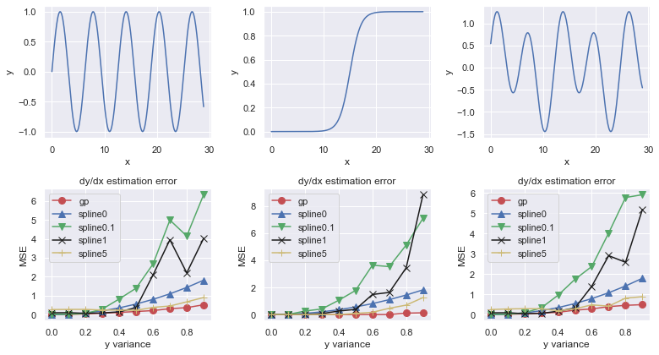
GPR outperformed spline in synthetic dataset experiments.

Slide 25
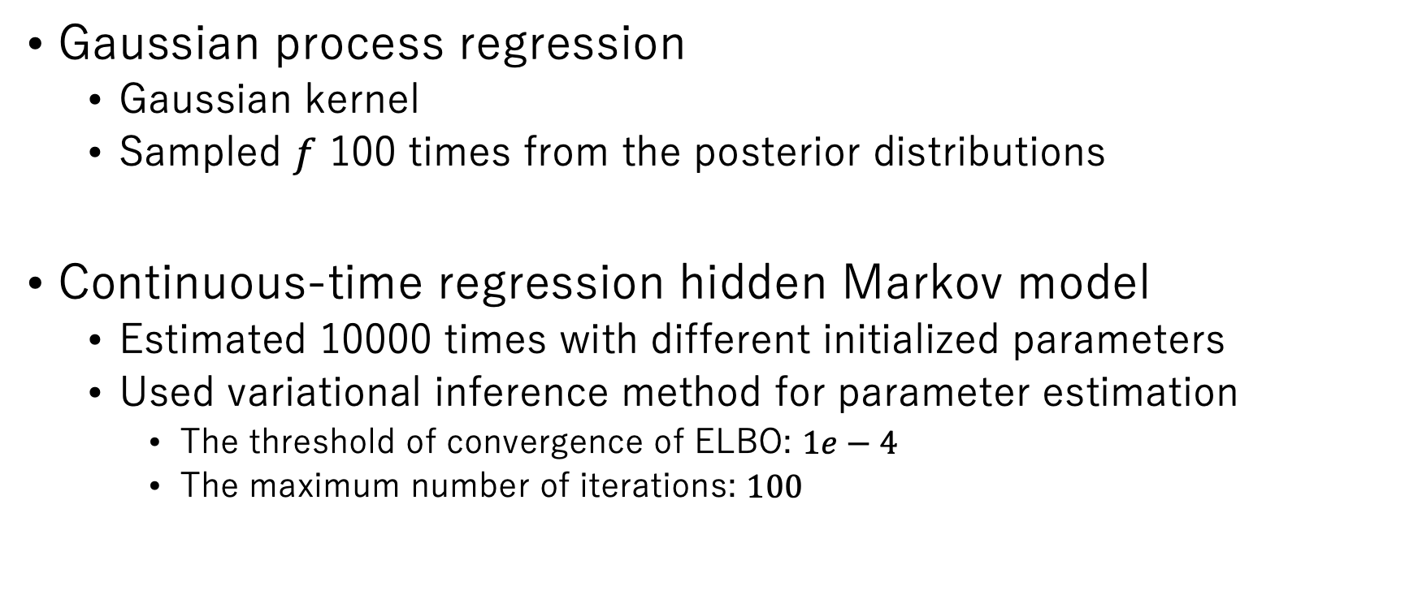
Experimental set-up
Gaussian process regression
Gaussian kernel
Sampled $f$ 100 times from the posterior distributions
Continuous-time regression hidden Markov model
Estimated 10000 times with different initialized parameters
Used variational inference method for parameter estimation
The threshold of convergence of ELBO: $1e−4$
The maximum number of iterations: $100$

